Slide 1

PRSPM Practice Module Final Presentation
Covid-19 Vaccine Adverse Effect Analysis
Group 03
Members:
Antonia Devina, A0127686R
Benjamin Quek Xiang Yi, A0229973M
Chwa Choon Xiang A0229962R
Gerard Ong Zi Quan, A0229967H
Nov 2021

Slide 2
Introduction

Slide 3
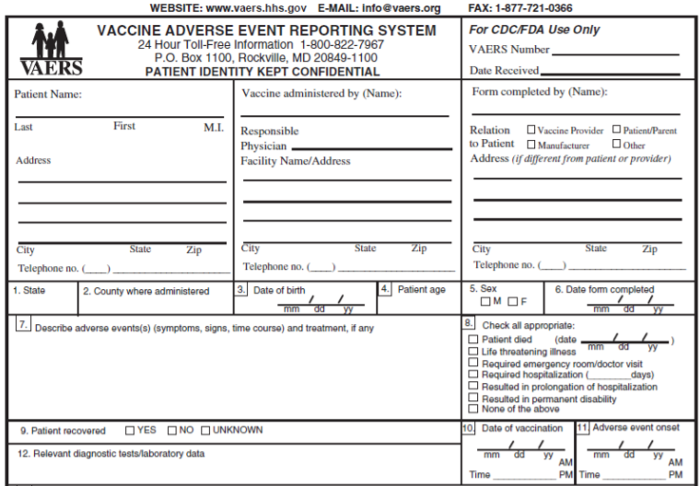
Background
COVID-19 vaccines are the de-facto means of controlling the pandemic
Adverse events have been reported against Covid-19 vaccines via VAERS
Adverse effects generated public hesitancy towards vaccination and has impacted government policies on economic recovery and travel restrictions

Slide 4
Project scope and objectives
Prediction of hospitalization from adverse effects
Project scope
Unstructured text classification for medical symptoms
Recommendation of clinical outcome from literature mining
Covid-19 Vaccine Adverse Effect Analyzer
Reduce workload in manual conversion of symptoms
Streamline admission of patients to remove pressure on healthcare system
Provide scientific evidence to address public concern on vaccines
Project objectives

Slide 5
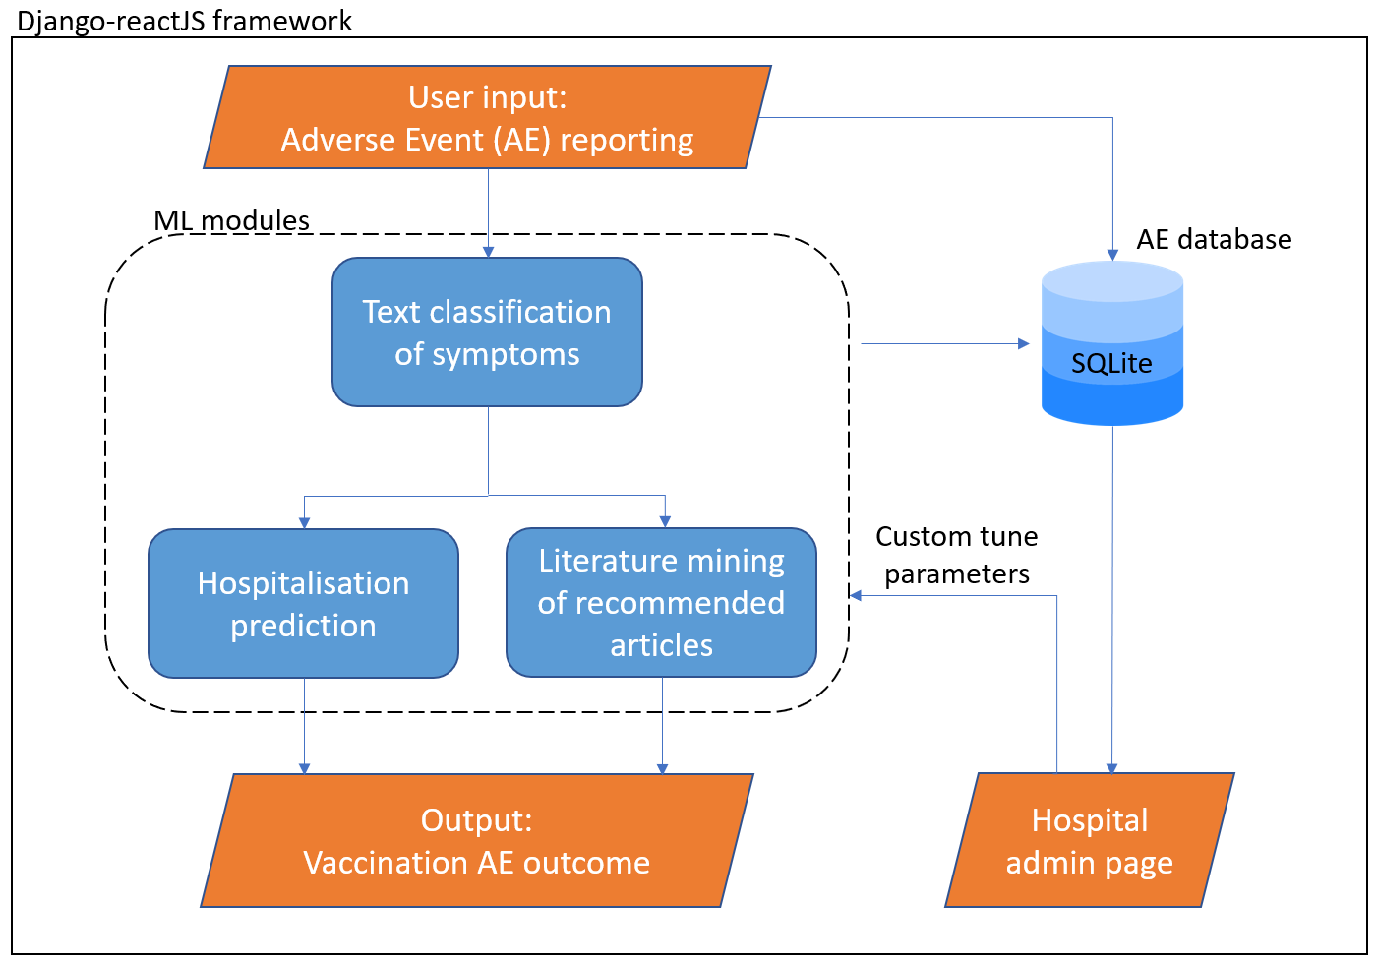
System overview

Slide 6
1. Text classification for adverse effect symptoms

Slide 7
Data pre-processing
Text classification for adverse effect symptoms

Slide 8
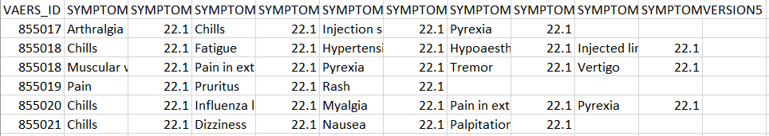
Data used
VAERS_data:
VAERS_ID (Unique patient identifier)
SYMPTOM_TEXT (Symptom free text recorded by healthcare worker)
VAERS_symptoms :
VAERS_ID (Unique patient identifier)
SYMPTOM1 – SYMPTOM5 (Up to 5 unique symptom per row)

Slide 9
VAERS symptom data pre-processing overview
Symptom free text
VAERS_data
Down-sample
One-hot encode
Add non-hospitalized symptoms
Non-hospitalized symptoms
21 hospitalized symptoms
21 hospitalized symptoms
Concatenate
Filter by symptom >100
Split into hospitalized and non-hospitalized
Concatenate symptoms into single column
VAERS_symptoms
Symptoms_clean
corrected_symptoms_clean_41
Concatenate
Down-sample
One-hot encode
Add non-hospitalized symptoms
Hospitalized symptoms
30 non-hospitalized symptoms
30 non-hospitalized symptoms
VAERS_ID
Free text recorded
One-hot vector of symptoms

Slide 10
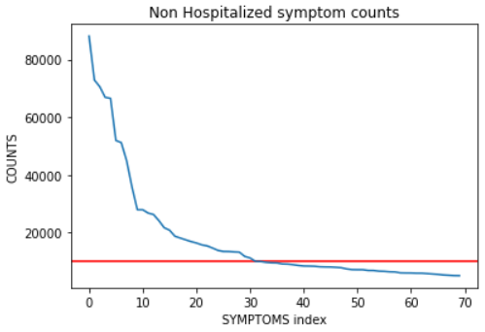
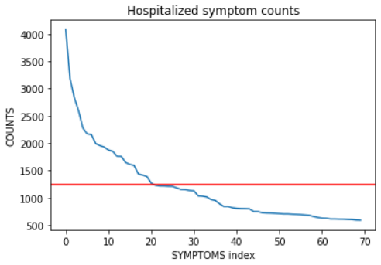
VAERS symptom down-sampling
Even after first filtering by symptoms that appear >100 times, still have over 14,000 unique symptoms
Impractical for model to predict 5 out of 14,000 samples per entry of free text
Employ elbow method to select most frequent symptoms:
21 symptoms for those who have been hospitalized
30 symptoms for those who are non-hospitalized
Concluded with 41 total symptoms after removing duplicates

Slide 11
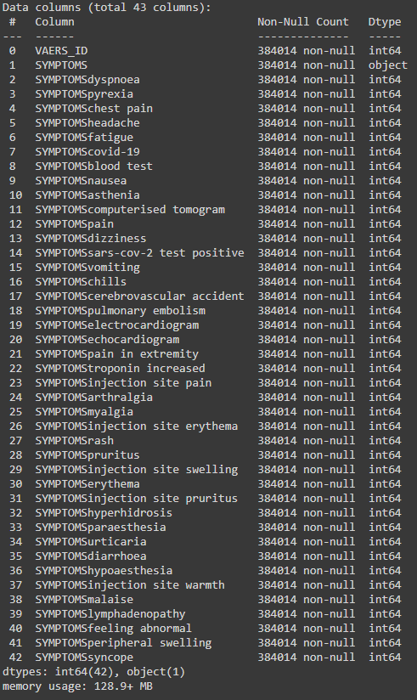
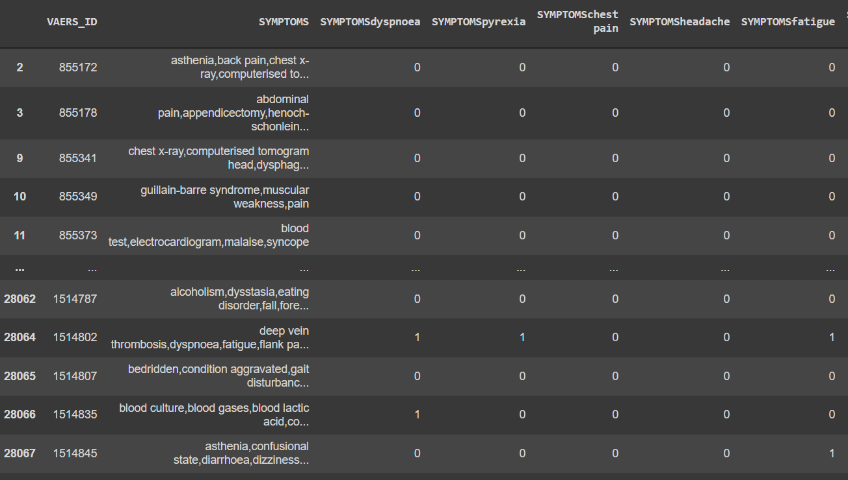
41 symptoms used

Slide 12
BERT Model
Text classification for adverse effect symptoms

Slide 13
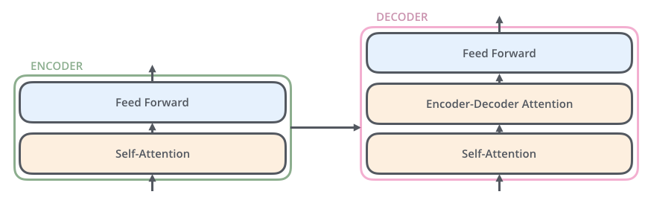
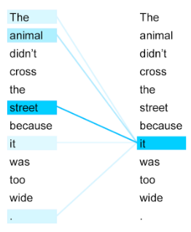
BERT model basics
Application of transfer learning in NLP
BERT utilizes Transformers which introduced concept of Self-Attention
Self-Attention allows for the model to get a better understanding of a certain word in the input sequence by looking at other words
The model reads the entire sequence of words at once instead of left-to-right or vice versa, allowing for bidirectional training in NLP
Notes:
‘Attention Is All You Need’ paper

Slide 14
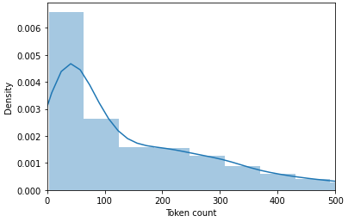
Application of BERT for symptom classification
Input: Symptom one-hot vector
150
InputLayer(None, 150)
BERT-base-uncased
Distribution of length of tokenized symptom free text
Output: pooler_output
Output: last_hidden_state
Global Average Pooling (None, 768)
Dense
Optimizer: RectifiedADAM
Activation: Sigmoid
Loss fn: BinaryCrossentropy
Output (None, 41)

Slide 15
TF-IDF SVM Model
Text classification for adverse effect symptoms

Slide 16
TF-IDF and SVM model
All the symptom texts are fed into the TF-IDF Vectorization and generated a matrix with shape of (number of statements, vocabulary size).
Characteristic of the matrix: sparse…
The value of the matrix is measured based on the comparison between the number of times a word appear in a doc and the number of docs that the word appears.
get | pain | stomach | someone | kick | taste
1 | 3 | 2 | 0 | 0 | 1
…
medicine | dizzy | chew | aspirin | taste | go
0 | 2 | 0 | 0 | 1 | 0
Number of symptom text
…
…
…
0 | 0 | 1 | 0 | 2 | 0
0 | 3 | 2 | 0 | 0 | 1
The score on each vocabulary

Slide 17
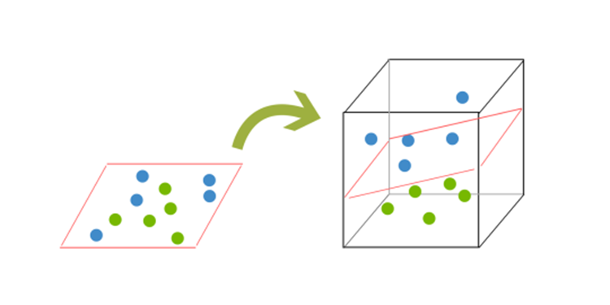
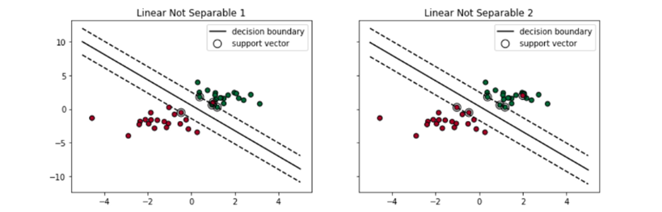
TF-IDF and SVM method
To deal with the sparse dataset, a SVM is used as model for the text classification.
Support vector machines (SVM) were the state-of-the-art ML model before the advent of Deep Learning due to its high accuracy.

Slide 18
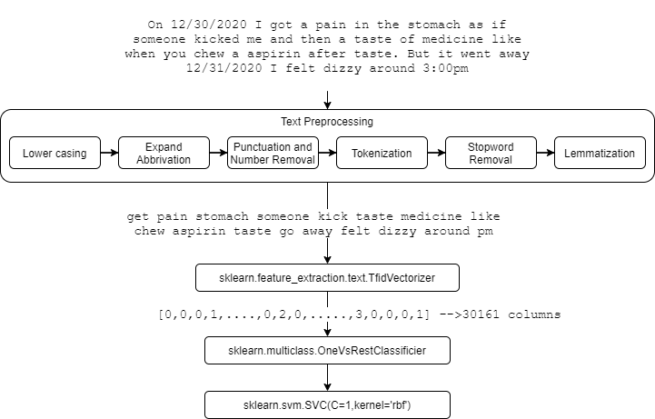
Flowchart

Slide 19
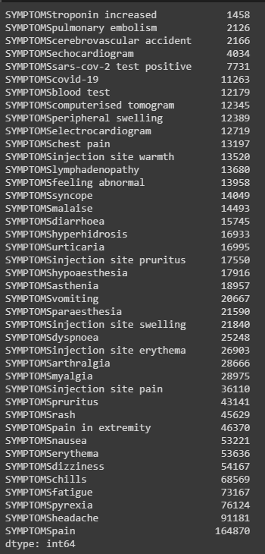
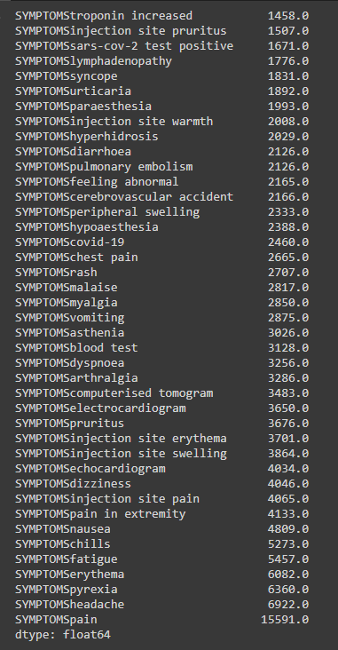
Data imbalance and resolution
→ Down sampling →

Slide 20
Word2Vec DL Model
Text classification for adverse effect symptoms

Slide 21
Word2Vec DL Model
The tokenized symptom texts are fed into WordVec model to train the weight matrix which represented each distinct word (vocabulary) with a particular list of numbers (100, 200 or 300).
The weight will replace the parameters to be trained in Embedding Layers under the Neural Network model.
get | 0.016 | 0.000 | 0.016 | -0.051 | 1.07
pain | 0.021 | -0.051 | 0.000 | 0.021 | -0.051
stomach | -0.003 | 0.036 | -0.051 | -2.10 | 1.07
…
0.000 | 0.021 | 0.000 | 0.051 | 0.003 | -0.061 | 0.021
-0.061 | 0.016 | -2.10 | 0.021 | 1.07 | 0.051 | 0.061
0.016 | 0.036 | -0.061 | 0.000 | 0.016 | 0.003 | 1.07
Type of vocabulary
…
…
…
medicine | 0.036 | 0.051 | 1.07 | 0.021 | 0.061
dizzy | -0.003 | 0.016 | 0.036 | 0.051 | -0.061
taste | 0.051 | -0.003 | -0.061 | 0.021 | 0.036
0.021 | 0.000 | 0.036 | -0.061 | 0.000 | 0.036 | 0.036
0.016 | -0.003 | 0.061 | 0.016 | 0.021 | 1.07 | 0.000
0.036 | 0.021 | -0.003 | -2.10 | 0.000 | 0.016 | 0.036
the level of semantic similarity between the words represented by those vectors

Slide 22
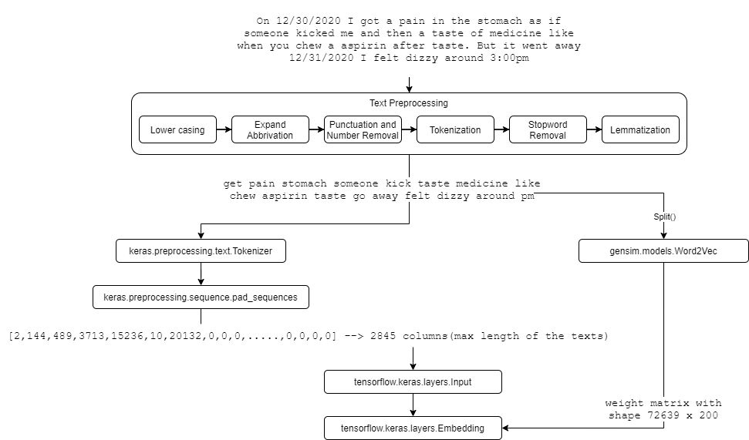
Flowchart

Slide 23
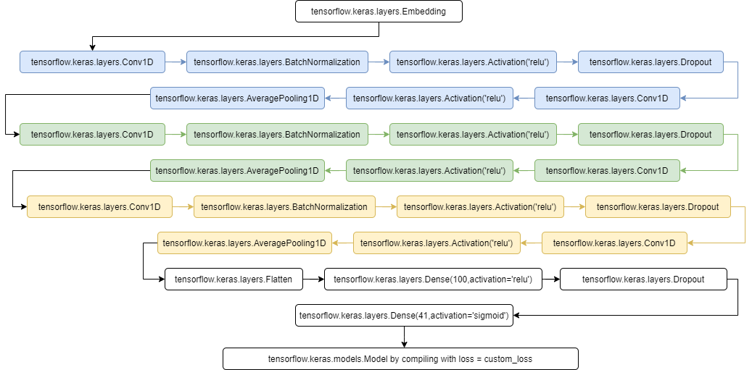
Flowchart

Slide 24
Data imbalance and resolution
A custom loss function to include the class weight of the dataset is applied during compilation of the model.
Normal loss function formula: BinaryCrossentropy()
Developed loss function formula:
[Class_Weight_Zero^(1-y_true)]*[Class_Weight_One^(y_true)]*BinaryCrossentropy(y_true, y_predict)

Slide 25
Hybrid Model
Text classification for adverse effect symptoms

Slide 26
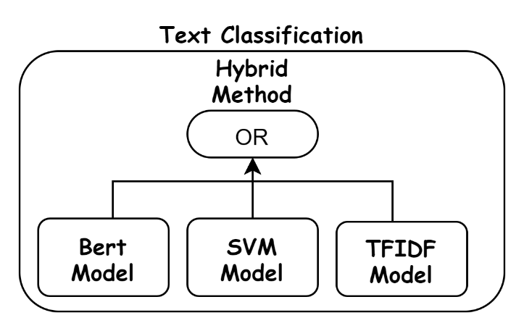
Hybrid Method
The model tends to predict fewer positive classes due to the large weightage of the negative classes in the dataset.
Any symptom predicted by the model will be considered as the confirmed symptom extracted through the text classification.

Slide 27
Results and discussion
Text classification for adverse effect symptoms

Slide 28
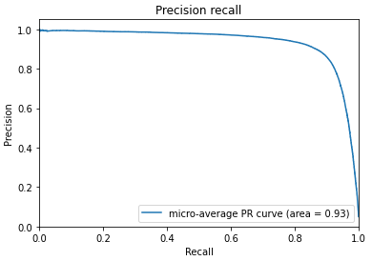
BERT model results
Micro-average Precision Recall AUC score: 0.93
AUC for precision recall used as our dataset has a larger proportion of negative samples due to the number of symptoms (imbalanced)
Precision is more focused in the positive class than in the negative class, it measures the probability of correct detection of positive values

Slide 29
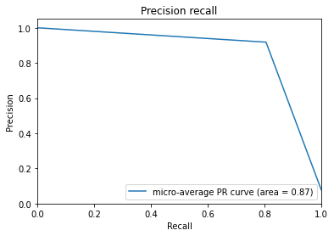
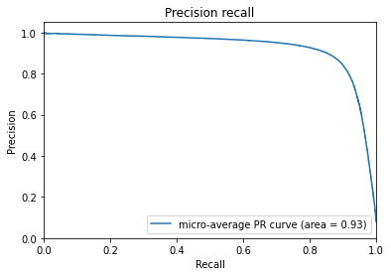
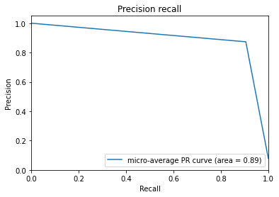
TFIDF SVM model
Word2Vec DL model
Bert model
Hybrid model

Slide 30
2. Hospitalization Prediction and Analytics

Slide 31
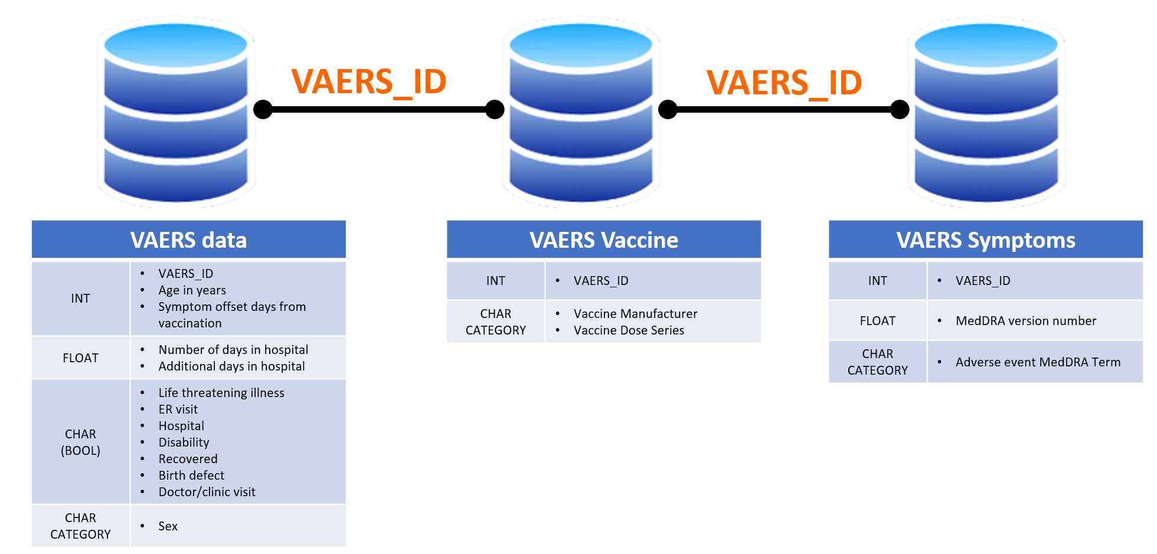
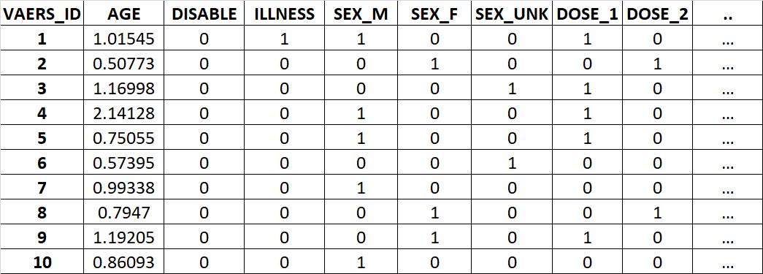
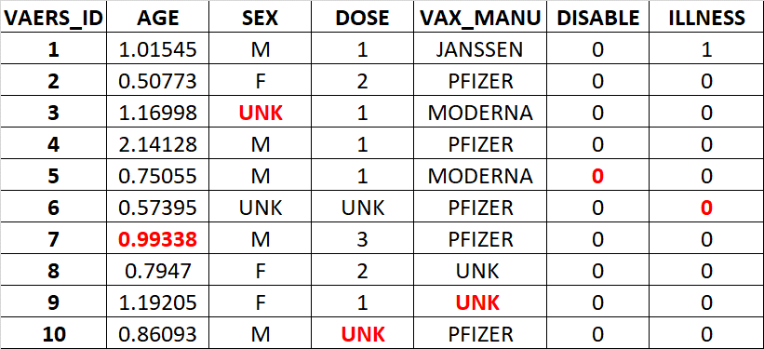
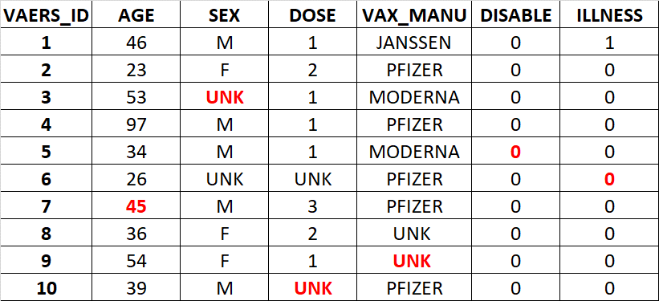
DATA PRE-PROCESSING
All the tables are combined into one data frame
Missing value are filled in base on mean / most common values / UNK [imputer]
Numerical values are standardized [standard scaler]
Category columns are one hot encoded [one hot encoder]
*For illustration only
Notes:
‘Attention Is All You Need’ paperAllAll

Slide 32
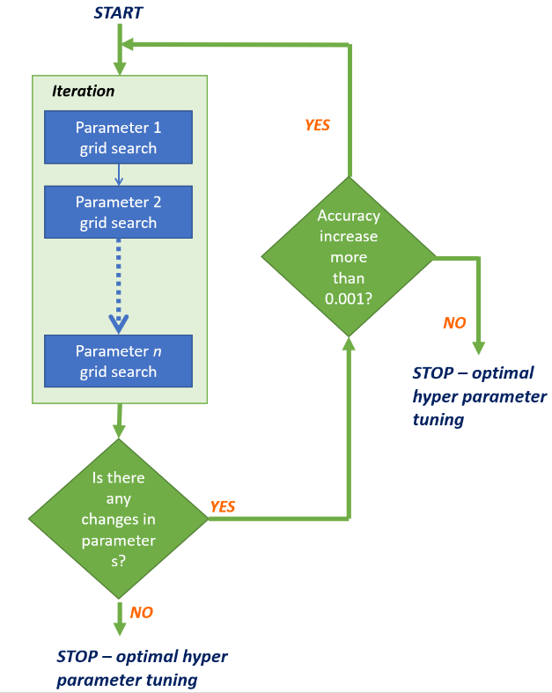
MACHINE LEARNING PREDICTION
XGOOST
RANDOM FOREST
LIGHT GBM
LOGISTIC REGRESSION CLASSIFIER

Slide 33
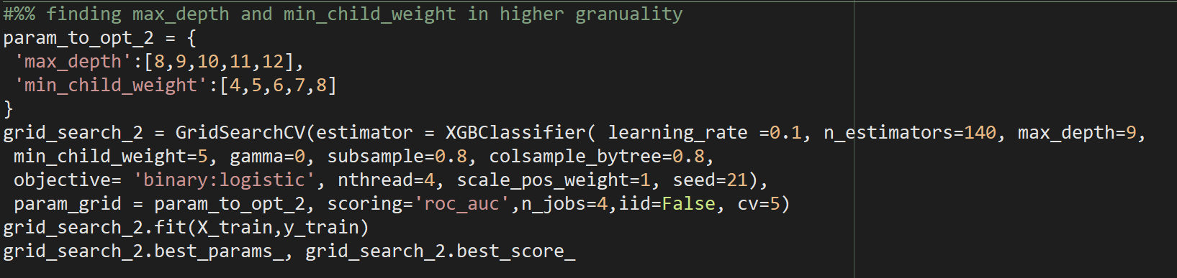
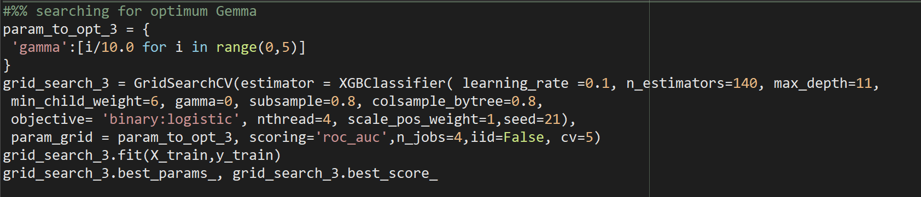
MACHINE LEARNING PREDICTION
Finding optimum parameter
XGOOST
RANDOM FOREST
LIGHT GBM
LOGISTIC REGRESSION CLASSIFIER
Next hyper parameter tuning

Slide 34
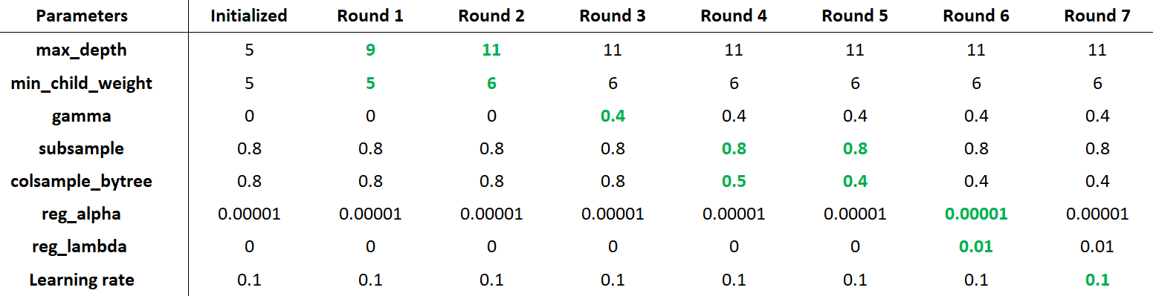
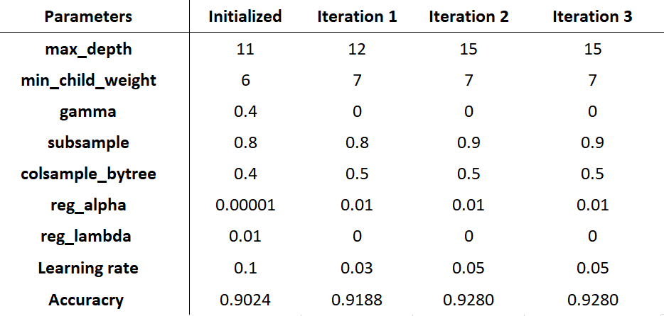
MACHINE LEARNING PREDICTION
One iteration consisting of many grid search
Complete Hyper parameter tuning
XGOOST
RANDOM FOREST
LIGHT GBM
LOGISTIC REGRESSION CLASSIFIER

Slide 35
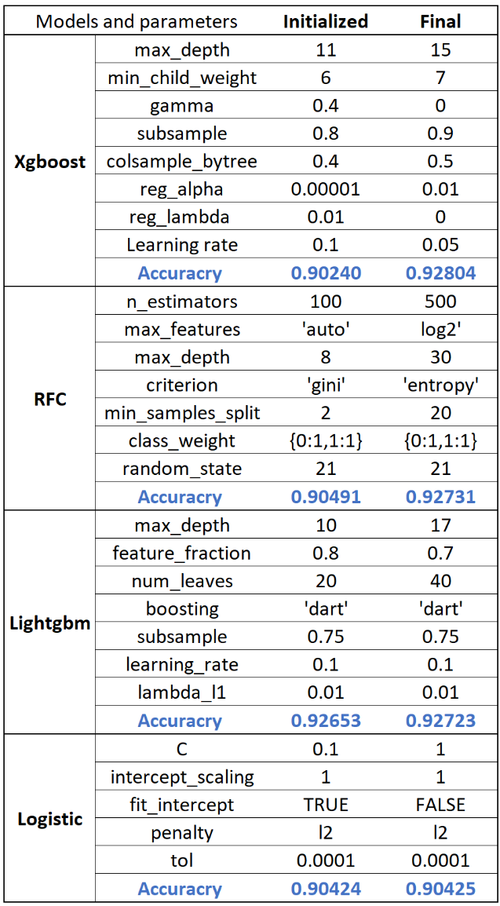
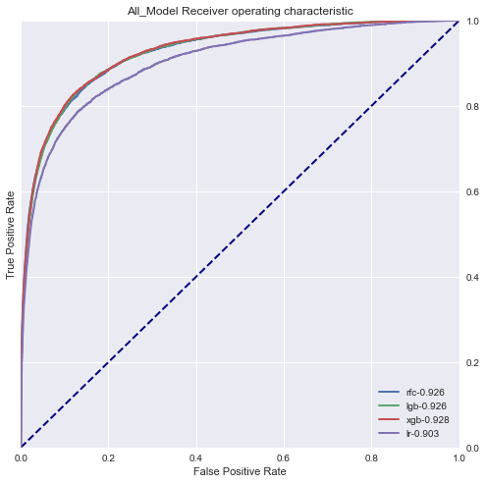
MACHINE LEARNING PREDICTION
XGOOST
RANDOM FOREST
LIGHT GBM
LOGISTIC REGRESSION CLASSIFIER

Slide 36
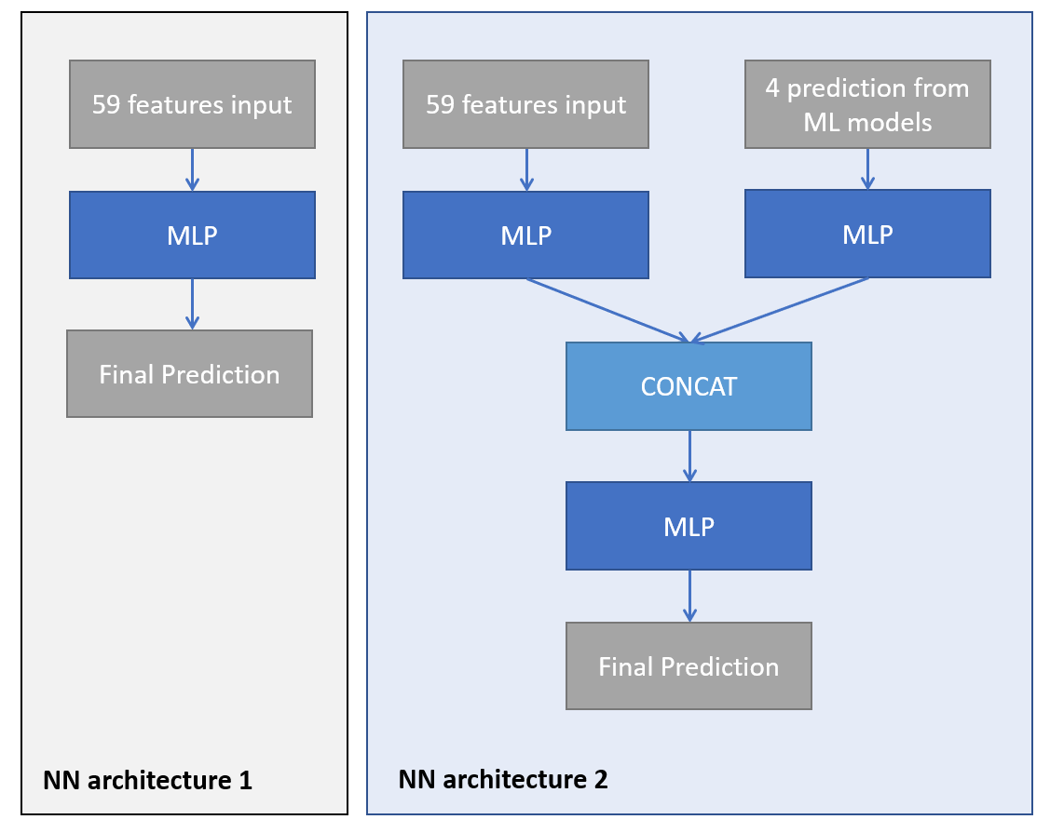
NN && ENSEMBLE PREDITION
Tuneable parameters
Activation function - ReLU activation function is used for all the activation layers beside the last output layer which uses sigmoid function.
Number of layers – The number of dense layers in each MLP were varied, from 0 (direct prediction / combination) to up 10 dense layers.
Number of Nodes – The number of nodes in each MLP were also varied between 3 to 350. As the number is too many, large increment was used first (e.g. 100) followed by lower and lower granularity. One outline that was found useful were, n+1 layer will have less than or equal to nodes as n layer.
Learning Rate – Adam optimizer used with different learning rate / constant and exponential decay.
Batch normalization / Dropout / Regularization – were used to reduced overtraining and stricter implementation are used in layers closer to the output layer.
Activation function location – the activation function can be in the dense layer (before batch normalization) or post batch normalization.
Two NN architecture evaluated:

Slide 37
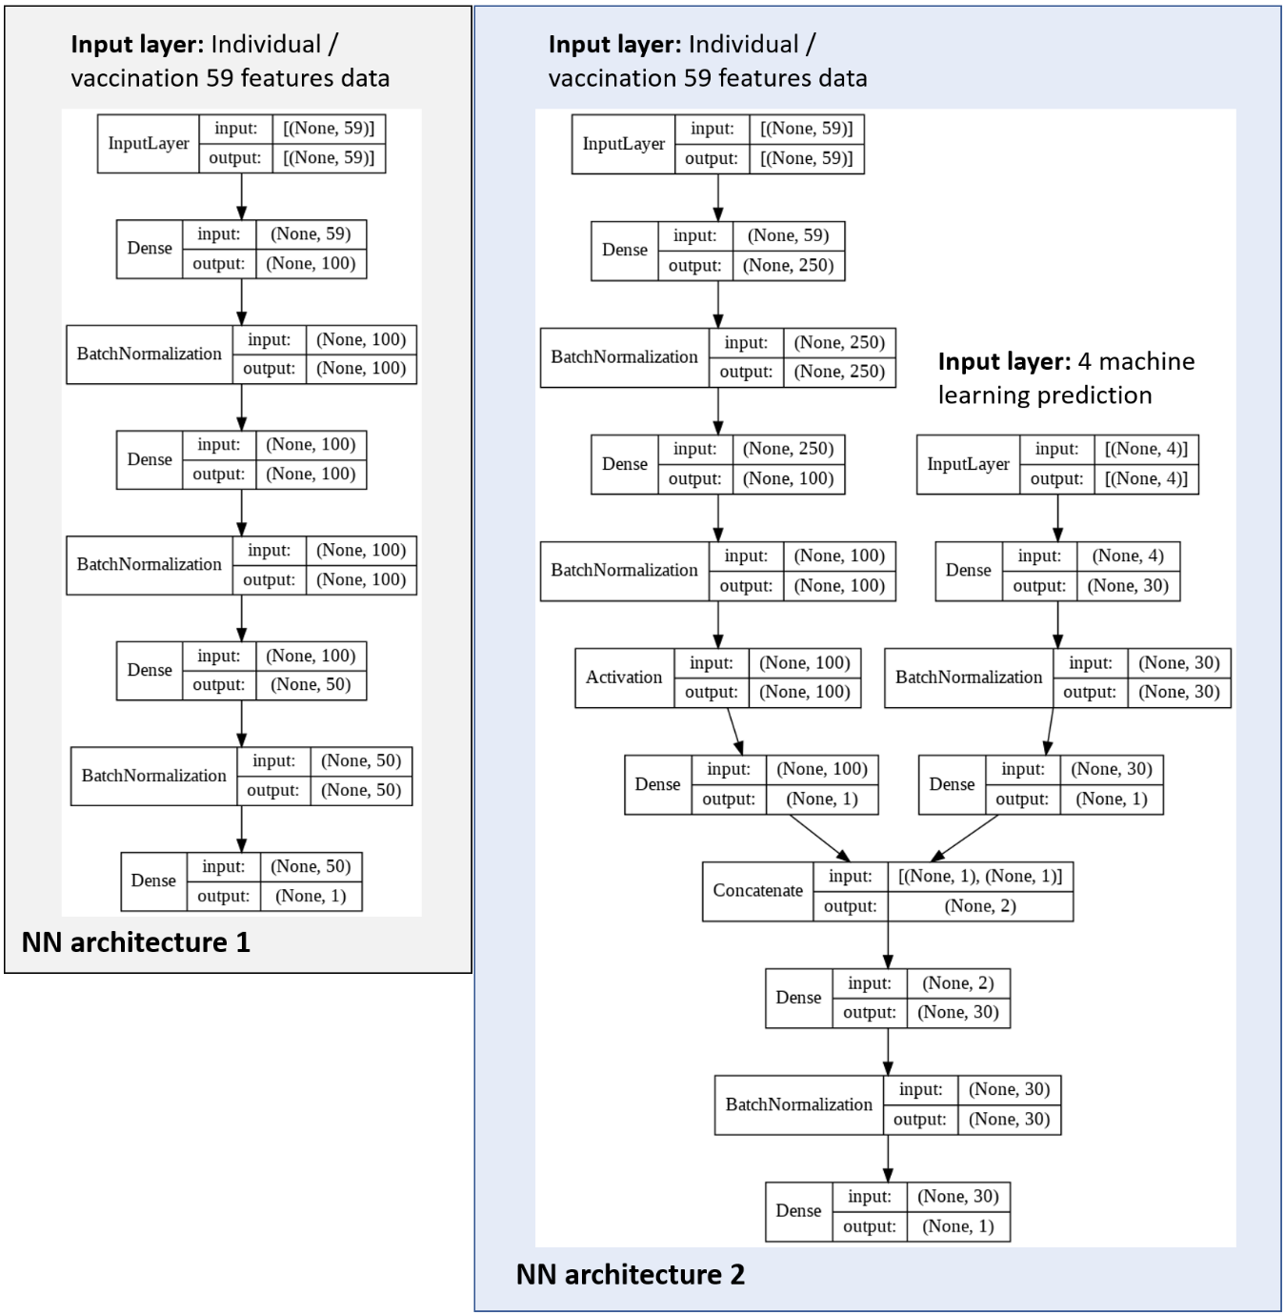
NN && ENSEMBLE PREDITION
Best Neural Network
Accuracy = 95.20%
F1-score = 0.4998
Accuracy = 95.48%
F1-score = 0.5544
Two NN architecture evaluated:
NN
NN + ML

Slide 38
Results and discussion
Hospitalization prediction and analytics

Slide 39
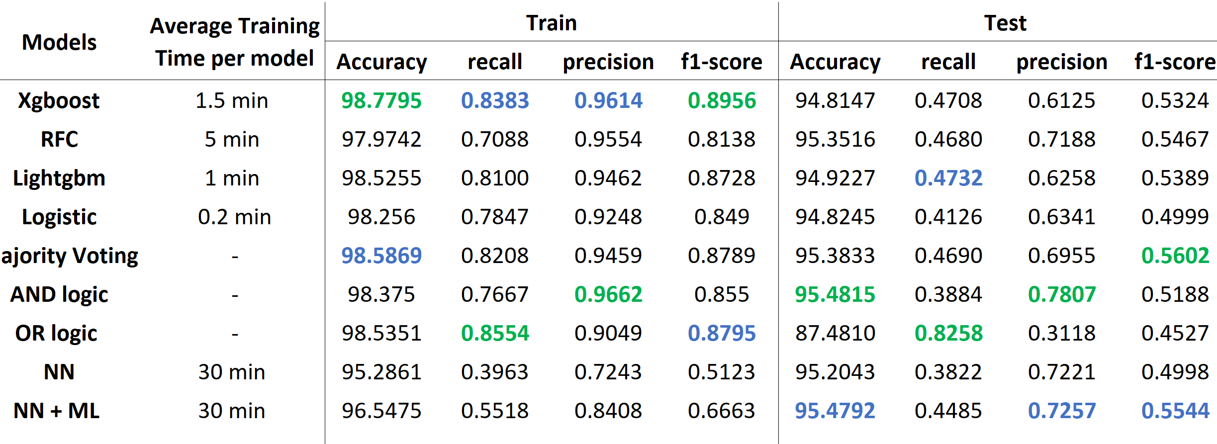
MODEL EVALUATION
ML models generally overfit on the training dataset although cross validation has been implementing during hyperparameter tuning and regularization / learning rate is part of tuned parameter.
AND logic voting – lowest recall highest precision
OR Logic voting – highest recall lowest precision
NN – model with least overfit,
NN + ML – although does not have the best individual performance matrix (accuracy, recall, precision, f1-score) however it is second in accuracy, precision, and f1-score.

Slide 40
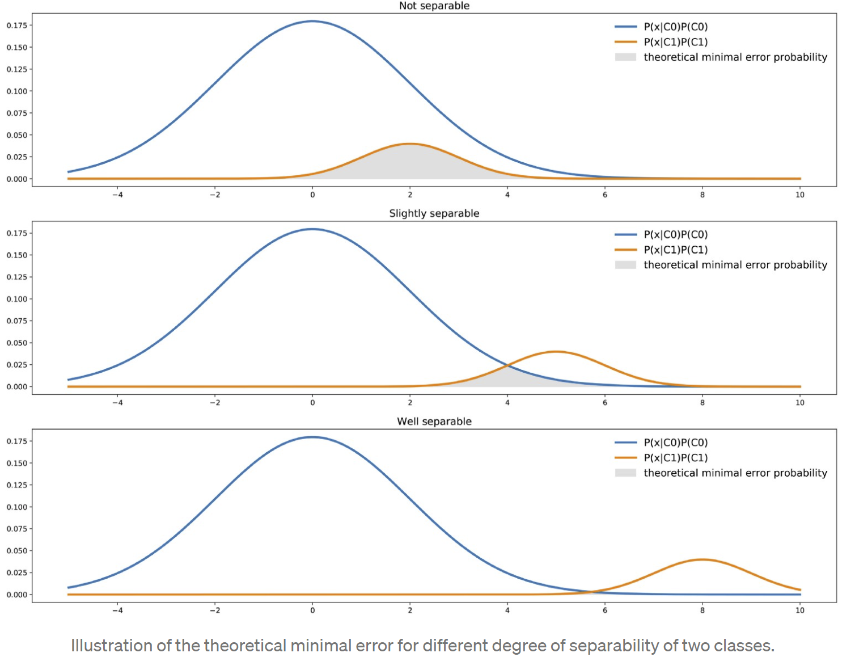
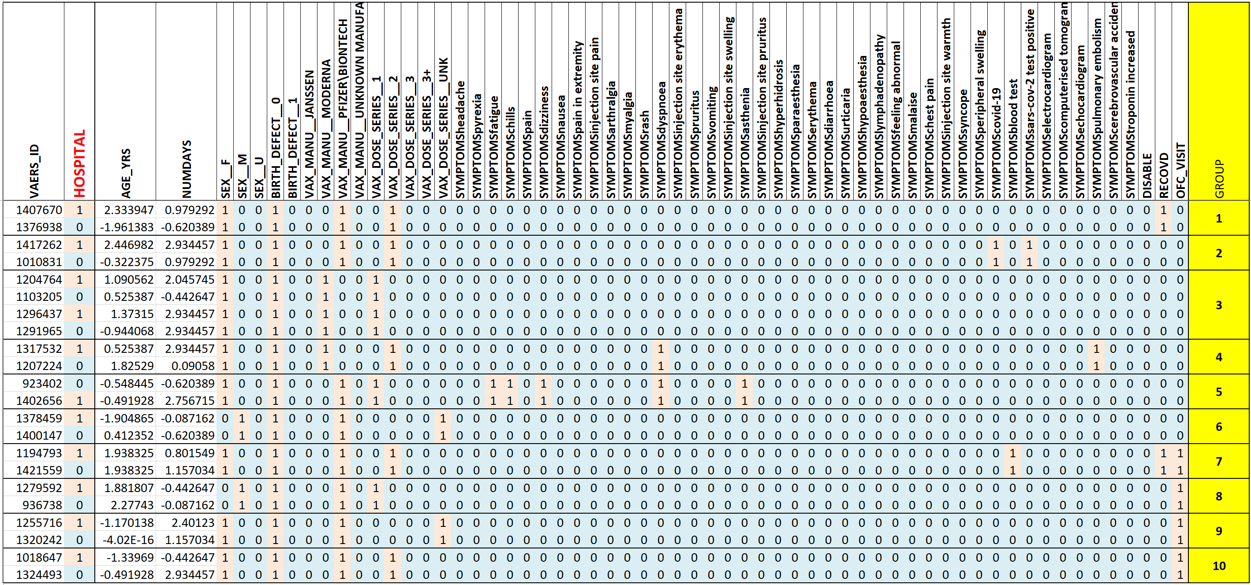
LIMITATION
Data separation

Slide 41
3. Covid vaccine literature mining and recommendation

Slide 42


Literature mining of Covid-19 vaccine adverse effect
Dataset pre-processing
Literature mining methodology
Results & Output

Slide 43

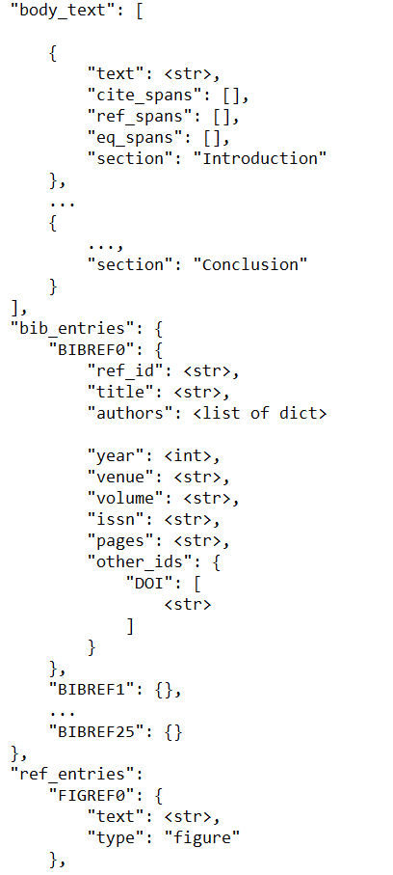
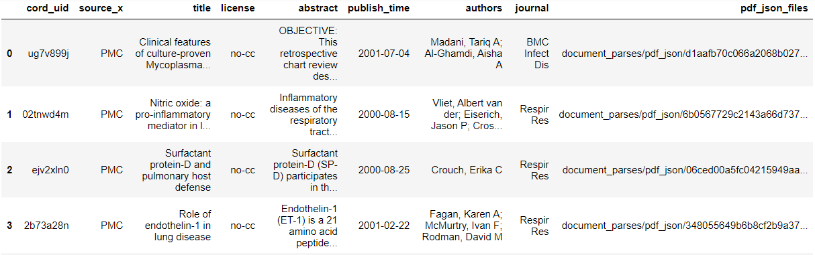
Dataset
JSON full text schema:
Covid-19 Open Research Dataset (CORD-19) released by Allen Institute for AI (AI2)
Contains >280,000 scholarly articles on novel coronavirus
2 main files:
1) Metacsv, for quick search filtering of dataset
2) JSON files of PDF full text information
Metacsv:

Slide 44
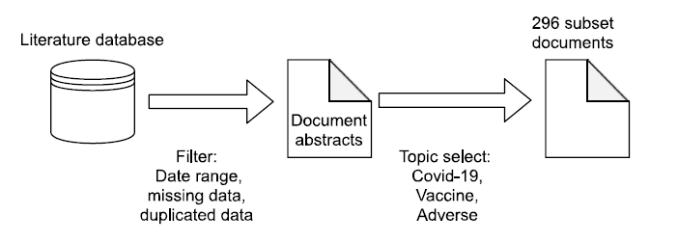
Data pre-processing
Pre-processing:
1) Selection of date range: Jan to Nov 2021
2) Removal of missing and duplicated articles
3) Topic select: Covid-19, vaccine, adverse

Slide 45
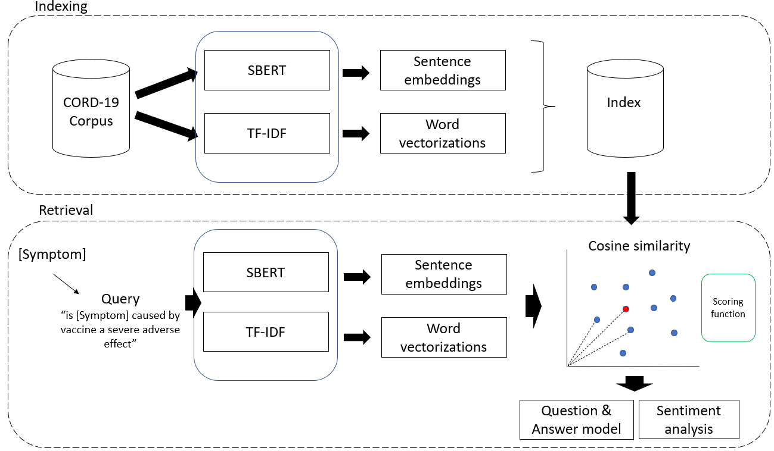
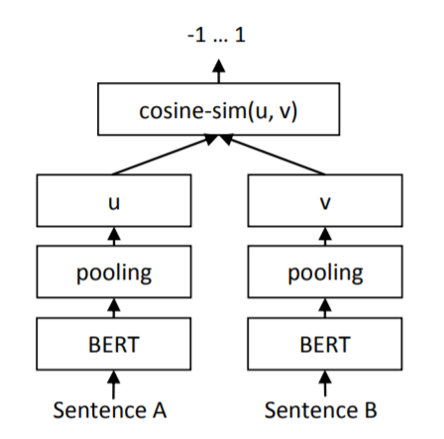
Literature mining methodology
Consists of 2 segments:
Indexing & Retrieval
Indexing:
Corpus is processed using sentence embeddings (SBERT) and word vectorisation (TF-IDF).
- Obtain semantic and statistical index
SBERT – Siamese BERT
Pretrained on MS Marco model for asymmetrical data
- Bing search engine

Slide 46
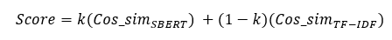
Literature mining methodology
Retrieval:
Symptom reported is converted to relevant query to be processed by SBERT & TF-IDF.
Scoring function was used to determine most similar paragraphs to query.
- k coefficient to distribute weight

Slide 47
Literature mining methodology
Retrieval:
QA model was used to obtain the answer to the query in terms of severity of the adverse effect.
QA model utilised BioBERT Pubmed trained model and fine-tuned on SQuaD2.0 Q&A dataset.
- Biomedical text understanding
Output answer was evaluated using sentiment analysis to provide alert status to users.

Slide 48
Output & Results
Effect of score coefficient k:
When k is high, the text returned relevant paragraphs, but symptom may not be accurate
When k is low, symptom is accurate, but may not be relevant context to query
k = 0.7 returned accurate symptom and context
Symptom: Fever | k = 0.9 | k= 0.1 | k = 0.7
Sample text | 'In the population analysed, only one serious adverse event (0.05%) was reported in an approximately 30-year-old female subject, who was immediately hospitalised after the second dose of vaccine due to symptoms similar to anaphylaxis (skin rash and glottal oedema). This serious adverse reaction was completely resolved within 24 hours.' | 'In general, the fever of tumor patients can be divided into tumor fever, drug fever, and infection. Tumor fever refers to the response of the immune system to tumor necrosis and stress factors produced by tumors which is generally ≤38.5 • C with no inducement and lasts for a long time. Experimental treatment with antibiotics is ineffective (Pasikhova et al., 2017) . Drug fever means that fever occurs during medication and stops after drug withdrawal. The median time of fever caused by antineoplastic drugs is about 0.5 days after administration (Patel and Gallagher, 2010) . Fever caused by infection usually has a higher temperature and can be reflected by blood routine tests.' | ‘Overall, the most frequent adverse effects reported after the administration of the three vaccines considered in this review consisted of local reactions at the injection site (sore arm and erythema) followed by non-specific systemic effects (myalgia, chills, fatigue, headache, and fever). These adverse reactions are considered as the result of the immune system's reaction that occurs soon after vaccination (also referred to as reactogenicity) and resolves shortly [35] . Given the scale-up of mass vaccination campaigns across the world, severe adverse events may occur and will likely generate concerns among patients and requests for evaluation.’

Slide 49
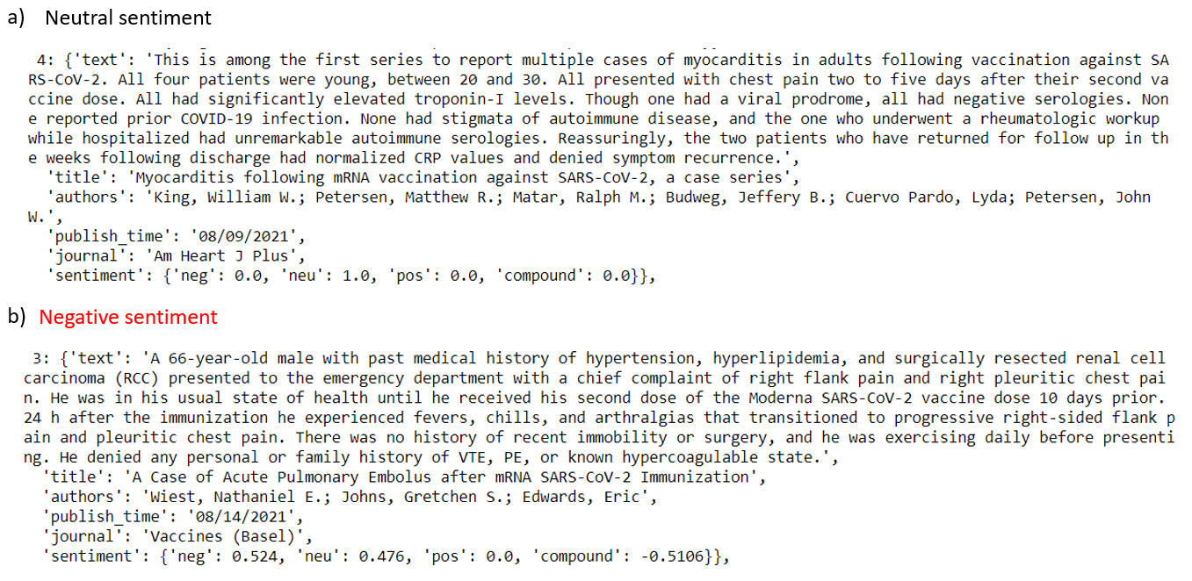
Output & Results
Sentiment analysis of “chest pain” symptom
Good recovery and no recurrence
Adverse symptoms progressed to more conditions

Slide 50
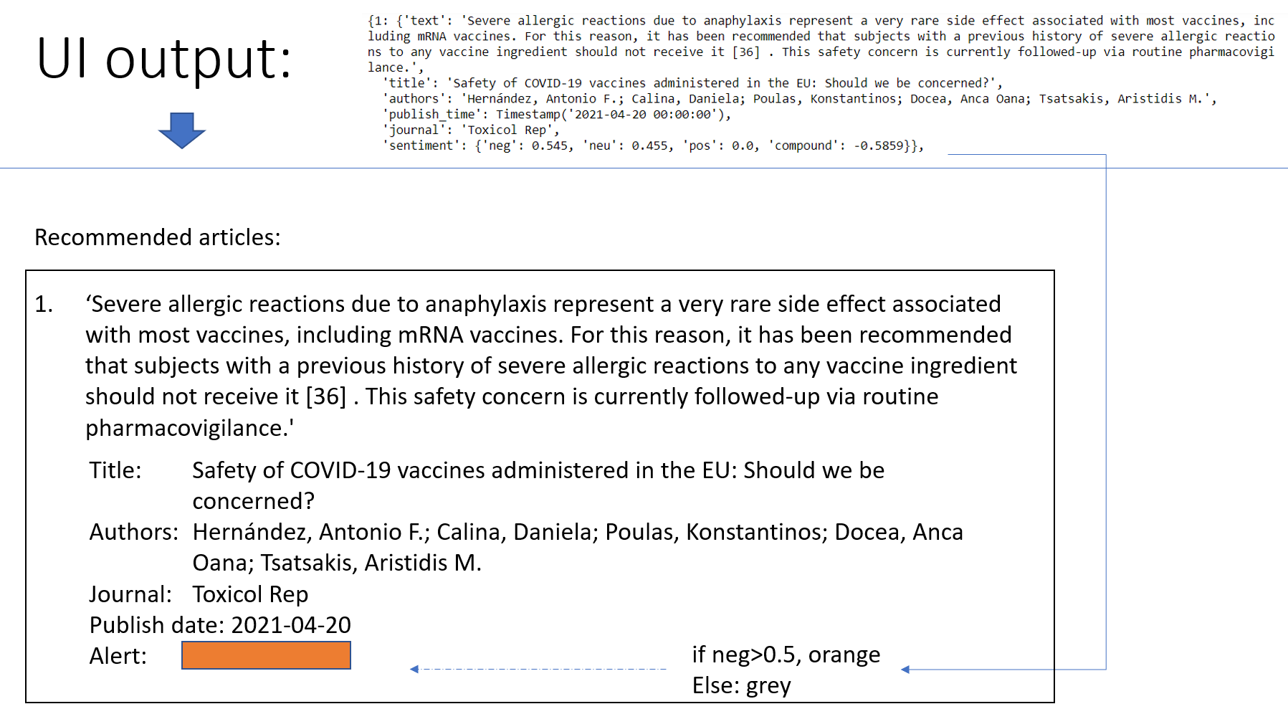

Slide 51
System demo

Slide 52


